Slide 1
TWO TIRED SOLUTIONS
Reinventing Bike Repair
Arthur Gomez, Eric Jiang, Michael DeCapua, Katrina Leyden
Notes:
MIKE
Hello everyone, I’m Michael, this is Arthur, Eric, and Katrina.
And our group, Two Tired Solutions would like to welcome all of you to our conversation on Reinventing Bike Repair

Slide 2
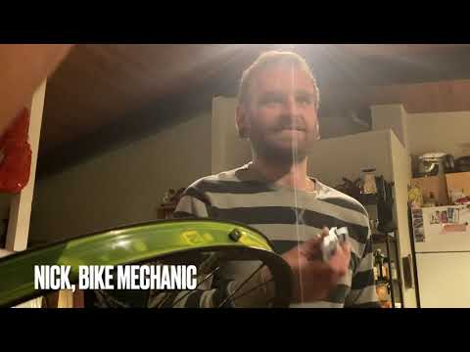
VIDEO
Notes:
ERIC
LINK: https://youtu.be/jMSsgZuRTMI
Cycling has long been one of the fastest, most flexible and reliable methods of transportation.
Even before the pandemic, millions relied on bicycles to do their jobs or get to work.
But when stay-at-home orders temporarily curtailed daily life across the globe, the role of bicycles transformed.
One in 10 American adults reported having ridden a bike for the first time in a year (or longer) since the onset of Covid-19.
And in March 2020, ridership on trails in the US peaked at a threefold increase compared with the same period in 2019.
In June 2020, bike sales rose 63% compared to the same time in 2019, reaching $697 million.
If there are more bikes being used, then there will be more repairs.
For bike riders, one of the most common problem they encounter are flats.
This particular bike repair is often the most frustrating yet important fixes for riders to know how to do.
-Interview with Dax
Tool: tire lever, and tire bead jack
Based on market research and interviews, riders need a tool that they can easily carry around for tire repair. Our tool is compact, incorporates multiple functionalities, and empowers riders to not only remove their tire, but put it back on too-- one of the biggest pain points for riders when repairing a flat.

Slide 3
Need Statement
Bike owners need a more convenient way to repair flat tires.
Notes:
ARTHUR

Slide 4
DESIGN EVOLUTION
Notes:
Arthur

Slide 5
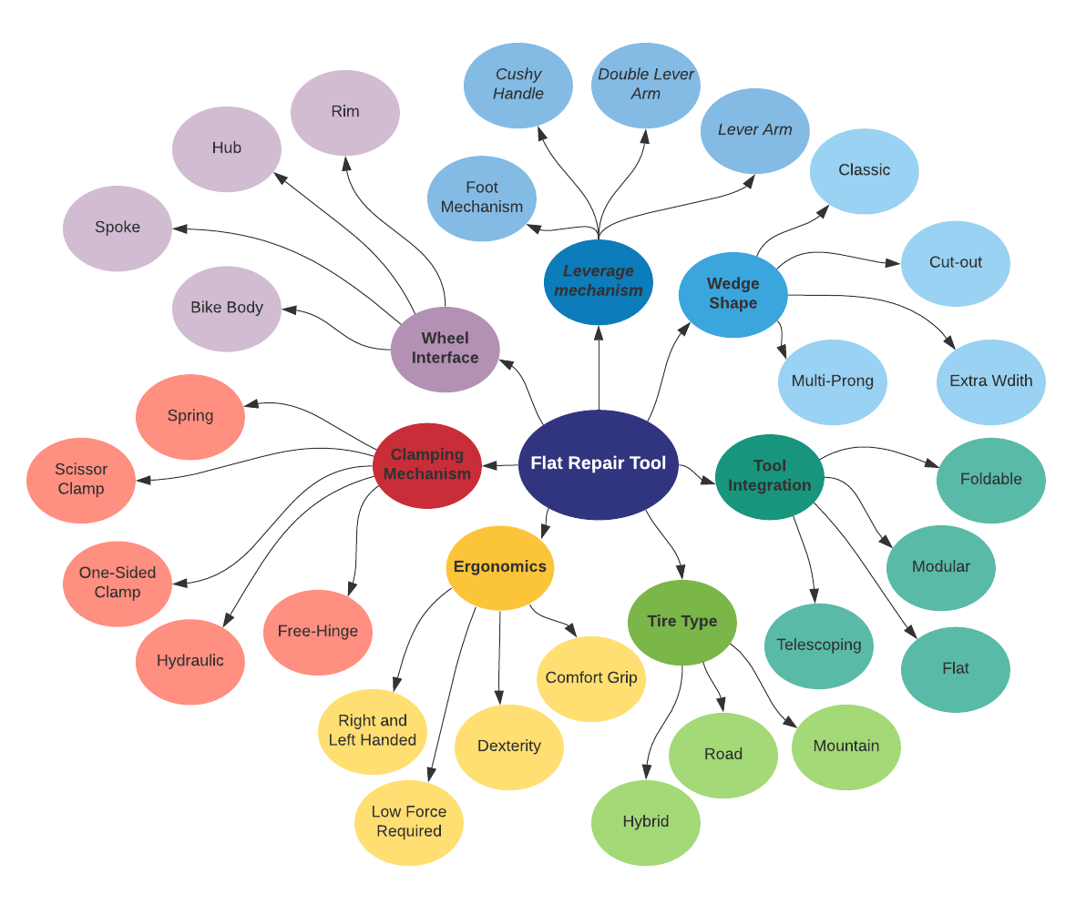
CONCEPT MAP
Notes:
** WE should go through these slides pretty quickly, capturing at a high level our ideation process. The different prototypes are meant to be a ***visual*** tools more than anything else, and a full description isn’t necessary.
Arthur
During the ideation phase, these were some of the concepts we came up with to think divergently based on some key features we identified such as ergonomics, tool integration, and leverage mechanism

Slide 6
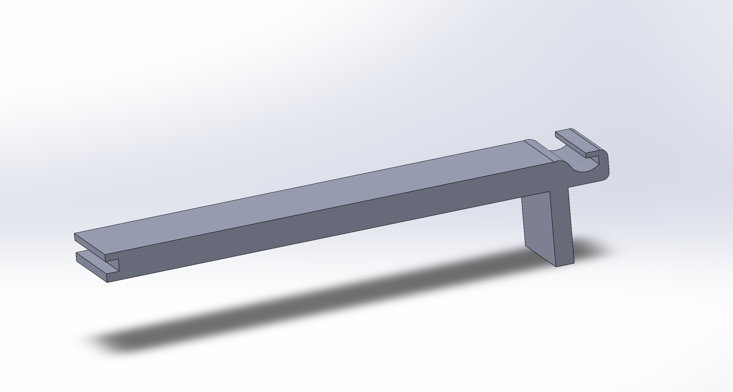
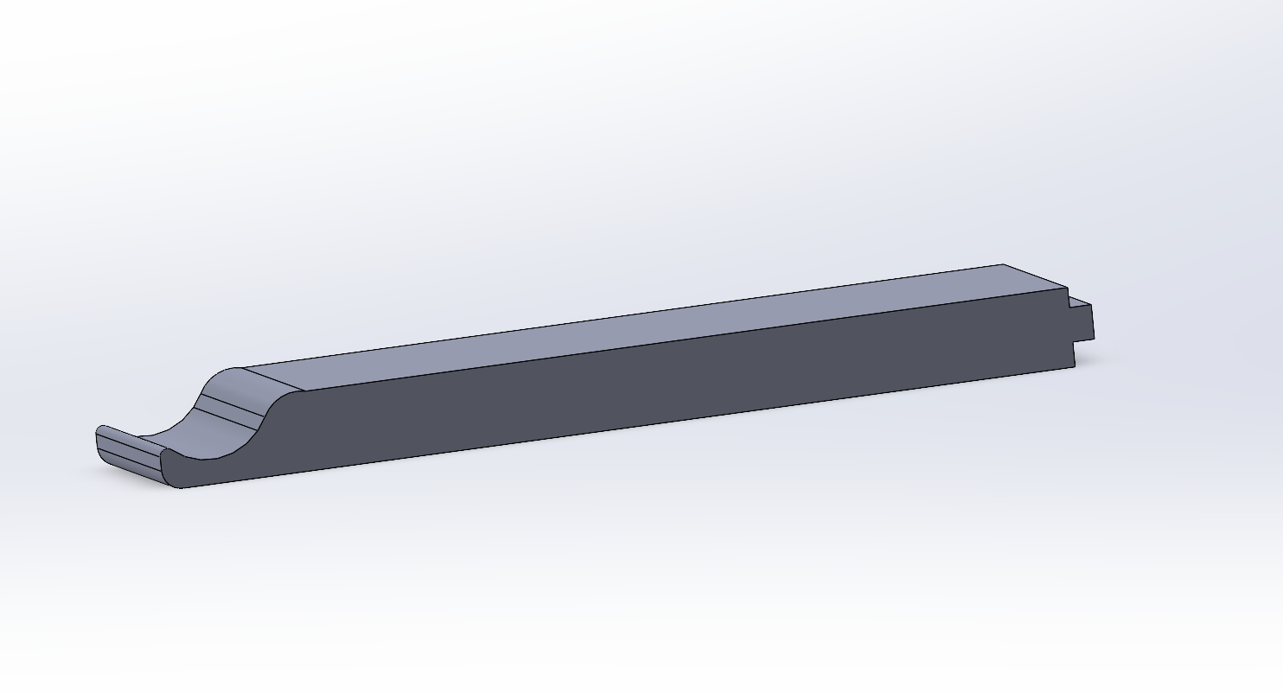
PROTOTYPE 1
Notes:
Arthur
Quick over view of the prototypes we tested
Our first prototype the attaching lever integrated several mechanisms such as being a semi-flat tool that could be utilized that utilized a lever arm to push the tire bead

Slide 7
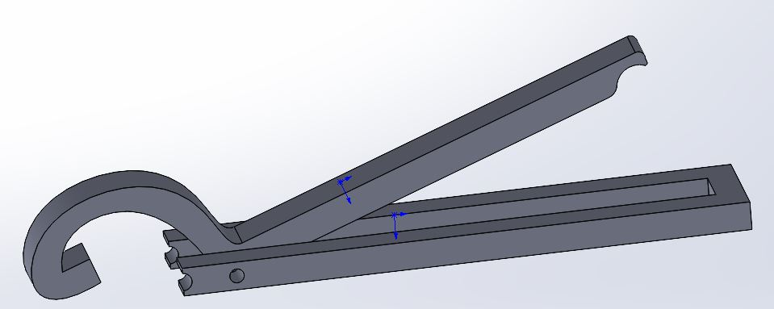
PROTOTYPE 2
Notes:
Arthur
The second prototype, foot lever, was inspired by how can we generate the most force from our body and utlized a foot lever that would fold attach to the rim and clamp on one side

Slide 8
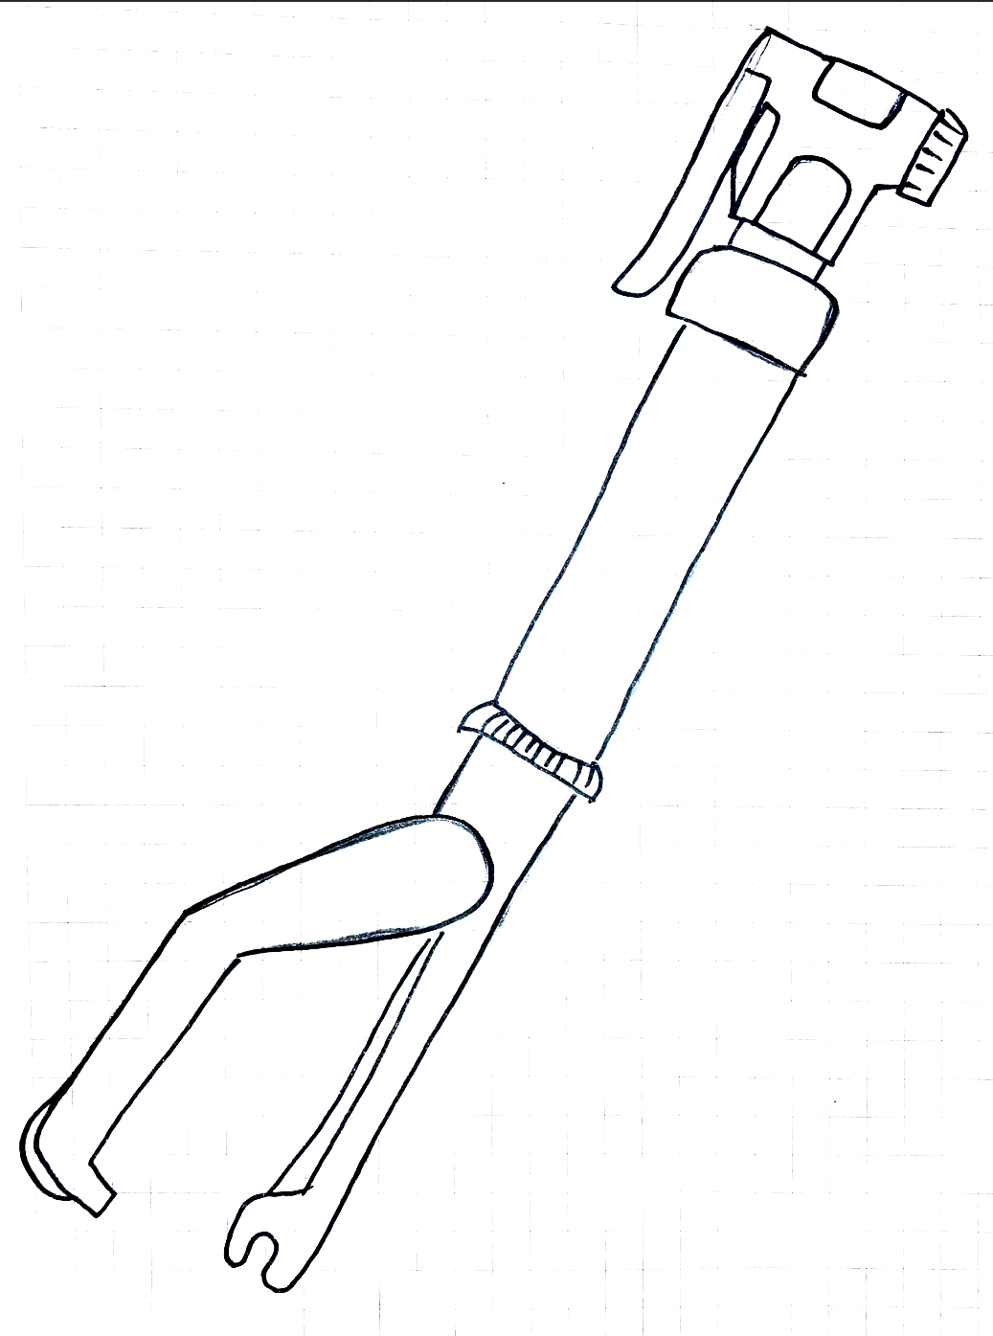
PROTOTYPE 3
Notes:
Arthur.
Our pump tire jack combined was meant to be a modular design that utilized a lever arm that would clamp to one side and included traditional bike levers in one design

Slide 9
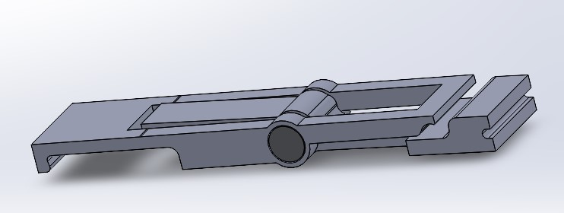
PROTOTYPE 4
Notes:
Arthur
Our removal/installation tool includes features such as scissor clamp and double lever arm that could easily

Slide 10
USER INFORMED FEATURES
OBSERVATIONS
INSIGHT
FEATURE
OBSERVATION
Riders need a tool to help with tire removal and installation
Tool needs to be multi-
purpose and add leverage
Tire Lever, Bead Jack (& more)
Suitable for 23mm-65mm tires
Riders need to a tool that doesn’t require a lot of bike knowledge
Tool needs to be easy to use
No assembly necessary
Straightforward Touchpoints
Riders need a tool that is easy to carry while riding
Tool needs to be packable
Sized for repair kits, pockets
Riders need a tool that is affordable and durable
Tool needs to be low-price
<$25
Notes:
KATRINA
STRESS FEATURES AND THEIR IMPORTANCE
FLATS
Current solutions for fixing flats are limited and not inclusive
See how mechanics constantly see folks coming in for help
Share anecdotes about the gentlemen at the workshop
Talk about the users’ struggle, and all our observations that led us here in the first place.
As Arthur covered, our design process included a lot of different iterations, and we used our prototypes and user feedback sessions as an opportunity to understand the needs of our user better. This informed our final product, and allowed us as a team to incorporate these needs into one, ultimate tool.
It’s not a matter of IF, but of WHEN a rider will encounter a flat during a ride. It’s a reality that all bike riders face eventually. First and foremost, we wanted to address our users pain points in process of repairing a flat tire. Levers are an essential part of a bike repair kit, but do little to help riders re-install their tires, sometimes one of the most challenging parts of the process, requiring the most amount of strength, technique, and dexterity.
CLOSING MARKS: Putting all these things together, we developed a tool to address the needs of our users

Slide 11
Introducing…
THE LUMBERJACK
Notes:
Mike
Now introducing, “The Lumberjack”

Slide 12
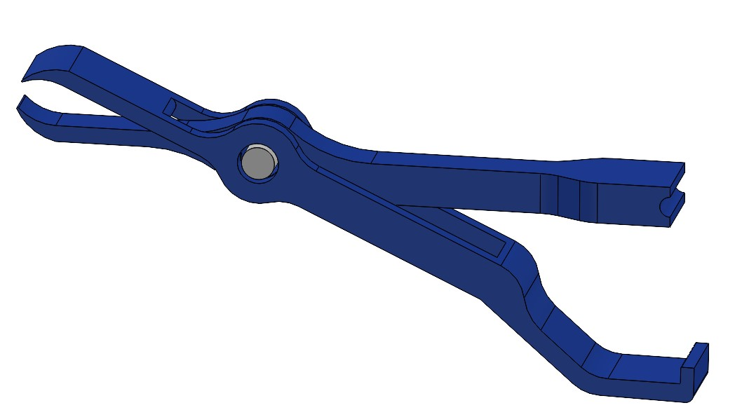
TWO TIRED SOLUTIONS’ “THE LUMBERJACK”
BIKE LEVER X 2
RIM POSITION
PIN
HOOK POSITION
Notes:
MIKE
User feedback
Features and why we picked the final one
Additional future iterations
Product name:
Two Tired Solutions has engineered, “The Lumberback, which is a two in one tool with defined bike levers with hooks for user’s could access their tire bead. This ease of use design is for our users to have the capacities for high accessibility of tire removal.
In being multi purpose, there is a rim position and hook for installation of tire beads back onto bicycle rims. Including long handles to leverage tire lips back onto rims.
Our users will now have a compact and packable tool for tire removal and installation.

Slide 13
MANUFACTURING/ASSEMBLY
Material Selection: Nylon
Lower Cost
Durable and Flexible Material
Manufacturing Process: 3D Printing and Injection Modeling
Components Included in Assembly:
Shoulder Bolt
Wing Nut
Notes:
MIKE
The lumberjack will be designed out of Nylon, being a harden plastic that is of low cost for manufacturing.
In selecting Nylon, our users will have a durable and flexible product for tire replacement.
Manufacturing will be 3D printing in the initial stages, then transition to injection molding for mass production.
Included in this assembly will be a shoulder bolt and wing nut for ease of disassembly and multi tool purposes.

Slide 14
BUSINESS PLAN
Notes:
Eric
Now, going into our business plan to how we are going to start up this project and to bring this tool into the market.

Slide 15
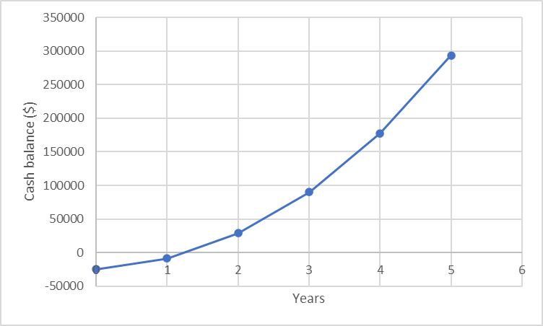
Business Plan
MARKET
Recreationalists, Commuters, Mechanics
A must-have tool for repair kits
SALES
Bulk Orders to Bike Shops
Online Retailers
$15-$20 price point
FUNDING
Local Bike Shop Sponsorship
Bike Industry Sponsorship
Crowd-funding
$25k start up (molds, 3D Printers, tooling)
12k units sold in first year
10% growth every year
$200k employee costs per year
$18 profit per part
Break-even at ~1 year
Notes:
https://www.weforum.org/agenda/2021/06/pandemic-bicycle-boom-covid19-united-states/
1. What service or product does your business provide and what needs does it fill?
2. Who are the potential customers for your product or service and why will they purchase it from you?
3. How will you reach your potential customers?
4. Where will you get the financial resources to start your business?
Assuming 25k start up cost ( molds, tooling) assumed 12k units sold in year one and 10% growth from then on. Also 200k in employee costs each year.
Assuming 18 dollars profit per part not including labor
Break even of a year approx

Slide 16
Questions?
Notes:
https://www.statista.com/statistics/763746/road-paved-surface-bicycling-participants-us/#:~:text=This%20statistic%20shows%20the%20number,amounted%20to%20approximately%2044.47%20million.

Slide 17
References
https://www.cnbc.com/2020/08/29/coronavirus-bike-sales-surge-schwinn-pivots-marketing-plan.html
https://rexplastics.com/plastic-injection-molds/how-much-do-plastic-injection-molds-cost
https://www.weforum.org/agenda/2021/06/pandemic-bicycle-boom-covid19-united-states/

